Slide 2

Module 3 –In Memory Computation
Spark DataFrames

Slide 3

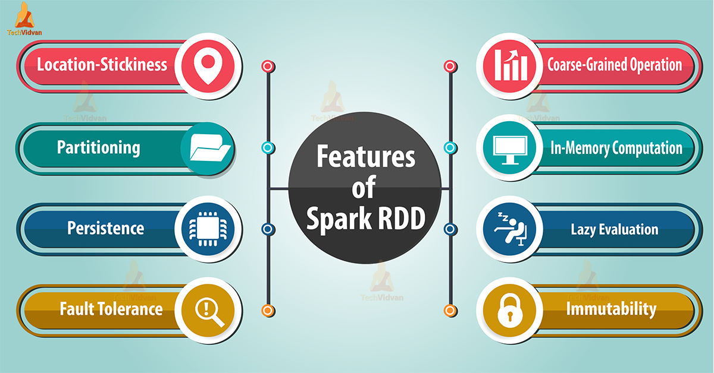
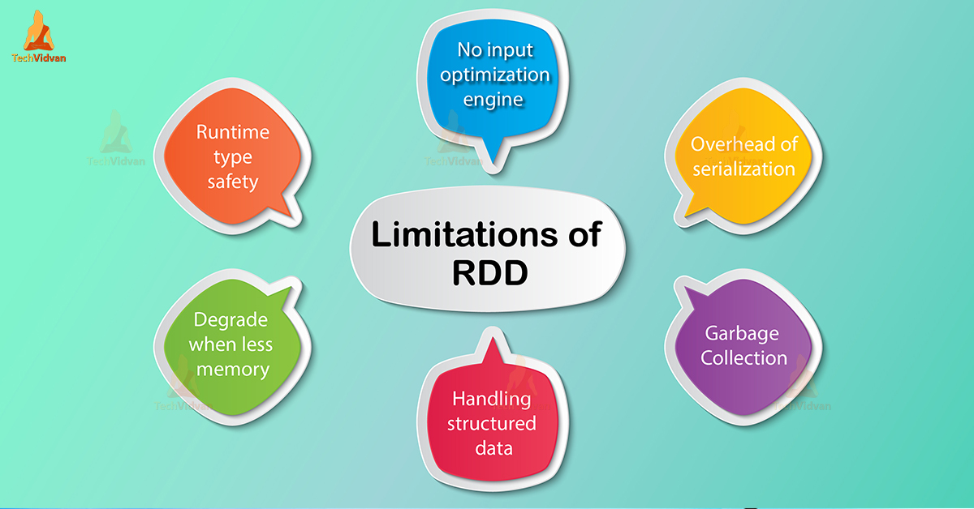
IN MEMORY COMPUTATION- SPARK
Can you think of some disadvantages of Spark RDD?

Slide 4
SPARK SQL – Dataframe API

Slide 5
IN MEMORY COMPUTATION-SPARK
Can you think of some disadvantages of Spark RDD?
Data RDDs are completely opaque to Spark
Meaning Spark cannot parse these values
Is there some way to make Spark understand the format, so that we can do processing more easily
Like sql type queries
Consider data like on the right that we need to run a query on?
USN | Name | Marks
45 | Vkoli | 11
10 | Stendul | 43
195 | Abachpan | 28

Slide 6
IN MEMORY COMPUTATION-SPARK
SPARK SQL
Introduced in 2015
Inspired by Dataframes in R and Pandas in python
Distributed collection of data into named columns
An abstraction built over RDD that allows
Schema to be defined on a RDD
Also has an optimizer built in for queries
USN | Name | Marks
45 | Vkoli | 11
10 | Stendul | 43
195 | Abachpan | 28

Slide 7
IN MEMORY COMPUTATION-SPARK
Features
Contain row objects
Can run SQL queries
Can have a schema
Read and write to JSON, HIVE,CSV
Communicates with ODBC/JDBC

Slide 8
IN MEMORY COMPUTATION-SPARK
Creating Dataframes
From pyspark.sql import Sparksession, Row
Spark=SparkSession.builder.appName(“SparkSQL”).getOrCreate()
input data= spark.read.json(datafile)
Inputdata.createOrReplaceTempView(“my structured”)
MyresultDataframe=sparl.sql(“ select from order by groupby)

Slide 9
IN MEMORY COMPUTATION-SPARK
Operations in Dataframes
Resultdataframe.show()
Resultdataframe.select(“someFieldName”)
Resultdataframe.filter(resultdataframe(“someFieldName”>100)
Resultdataframe.groupBy(resultdataframe(“some field”)).mean()
Resultdataframe.rdd().map(mapperfunction)

Slide 10
BIG DATA
Creating dataframes
Dataframes can be created from existing RDDs, HIVE tables other Data sources.
This example is creating from a JSON file
from pyspark.sql import SQLContext
sqlContext = SQLContext(sc)
df = sqlContext.jsonFile(“pes/students.json")
# let us display the contents
df.show()
## USN name marks
## 045 Vkoli 11
## 010 Stendul 43
## 195 Abachpan 28
Df = rdd.toDF(“age”, “name”)
Alternatively, from an existing RDD by naming the columns

Slide 11
BIG DATA
Using a dataframe
# Print the schema in a tree format
df.printSchema()
## root
## |-- usn: long (nullable = true)
## |-- name: string (nullable = true)
## |-- marks: long (nullable = true)
# Select only the "name" column
df.select("name").show()
## name
## VKoli
## STendul
## ABachpan
# Select everybody, but increment the age by 1
df.select("name", df.marks + 1).show()
## name (marks + 1)
## Vkoli 12
## STendul 44
## ABachpan 29
Notes:
Once built, DataFrames provide a domain-specific language for distributed data manipulation.
Here we include some basic examples of structured data processing using DataFrames:

Slide 12
THANK YOU

